Slide 1

The story of how I lost my mind
Or the Space Shooter Modifications I tried
Allie Arnott

Slide 2


The Trail of Mines
Notes:
My first planned task was homing mines, and this was actually the task that went mostly okay.
I’d planned to use vector2.distance, and I did end up making good use of it.

Slide 3

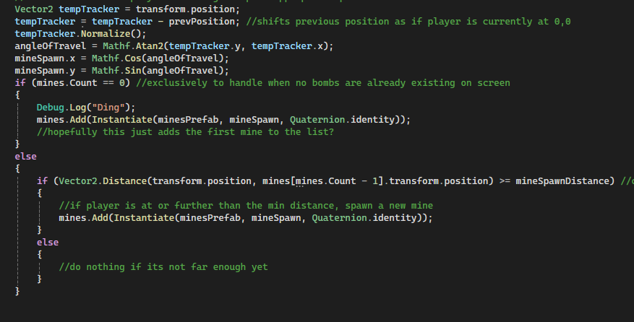

I learned Unity gets VERY confused when you ask if an empty list is empty
Unity can’t handle checking an empty list
Not even if it knows what is going to be in the list
I guess it needs an object to exist before it can check if it’s empty
Or in this case a list

Slide 4
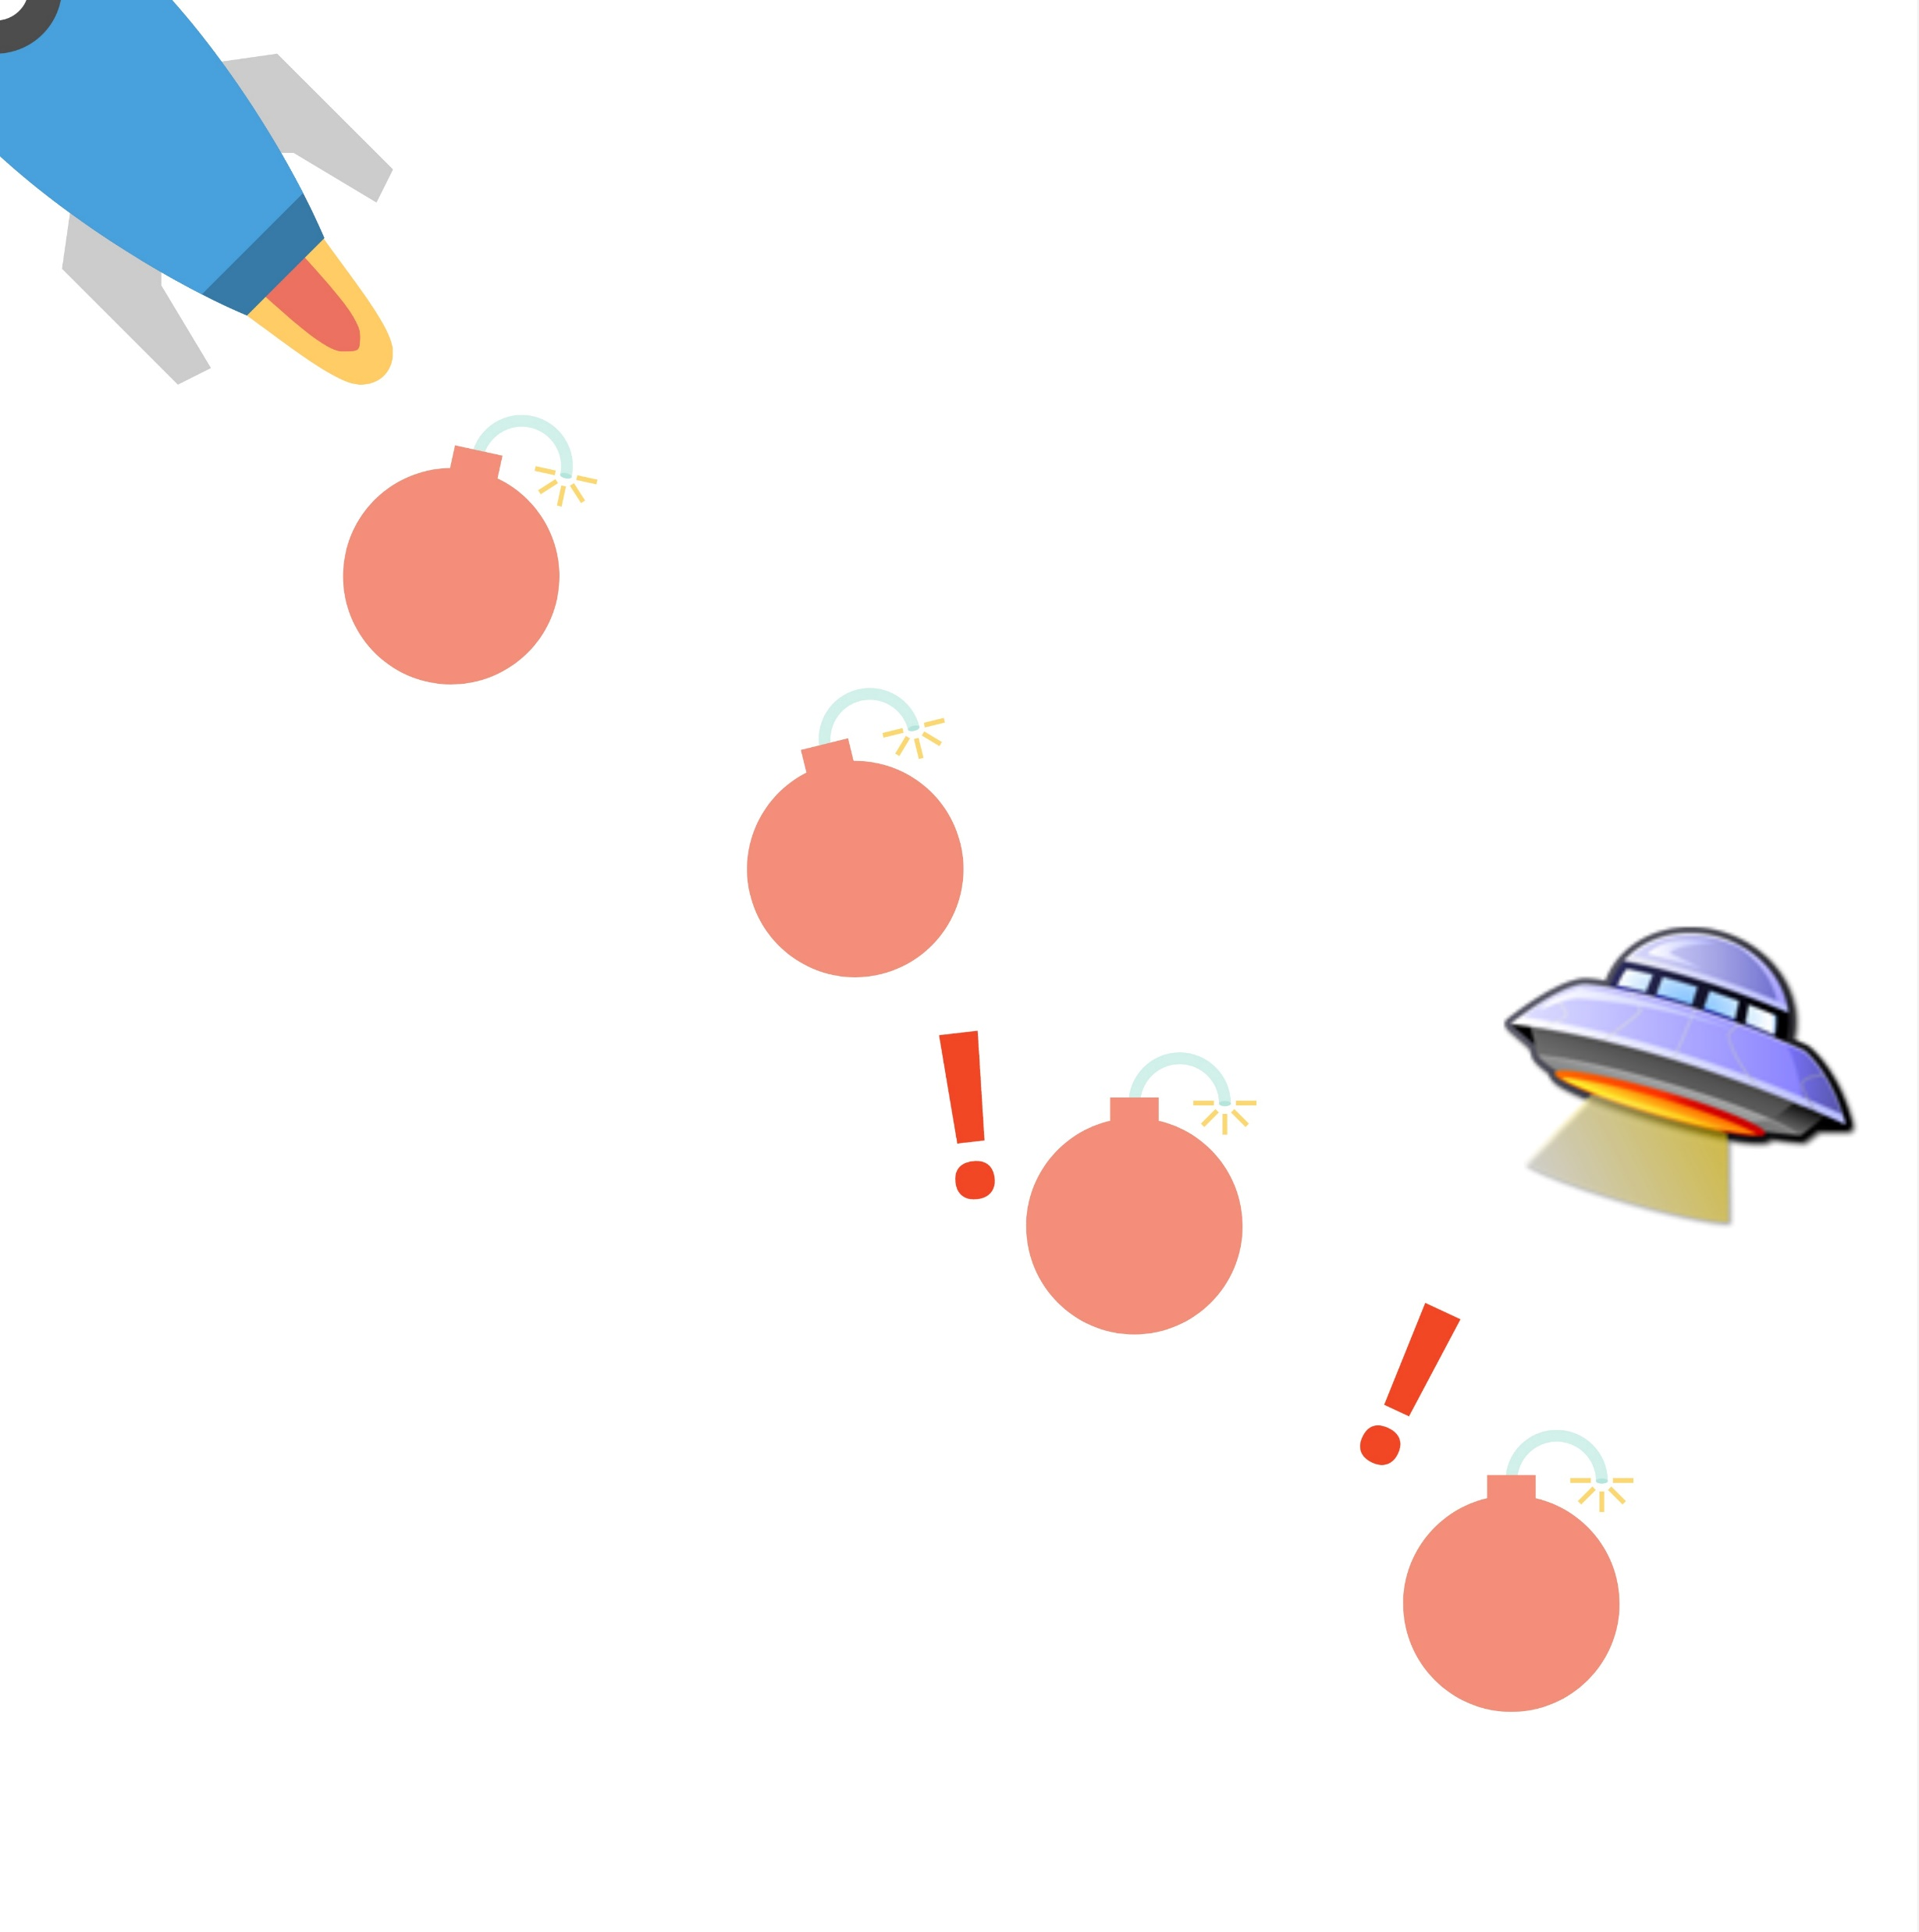
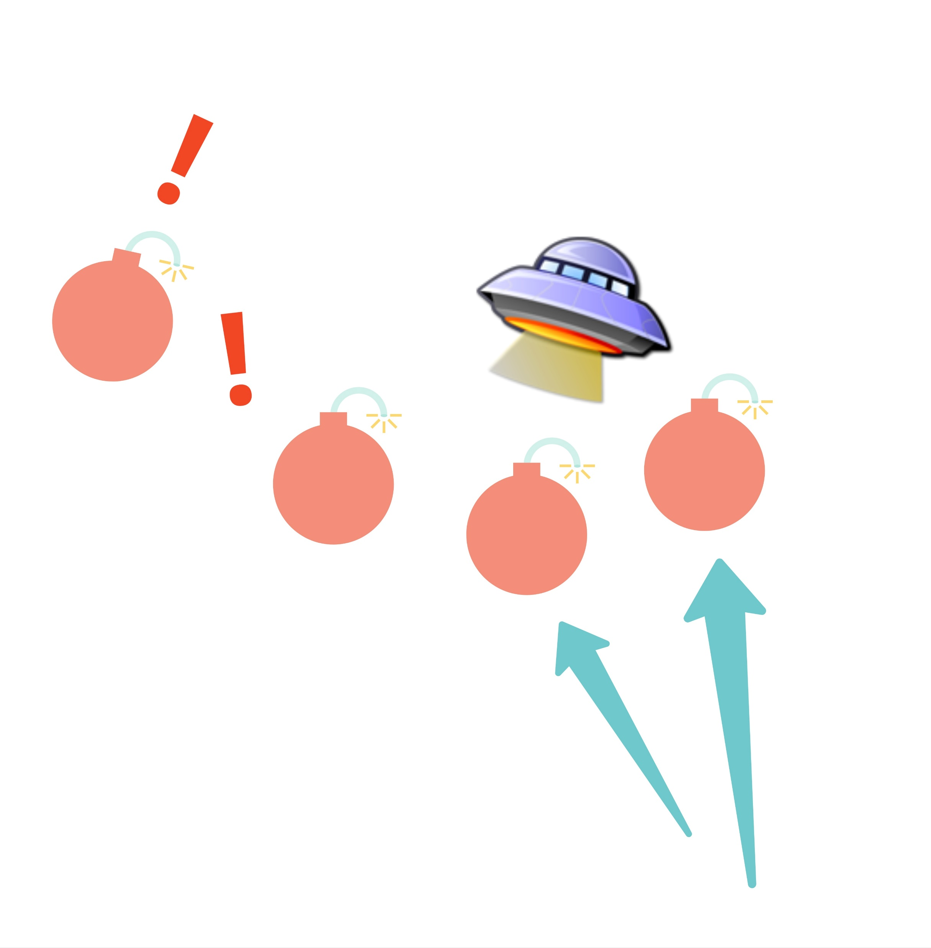
Mines on the move
Notes:
Then I was planning for the mines left by the player to move
I did end up getting them moving
But it sorta got a lil lost on the way there

Slide 5
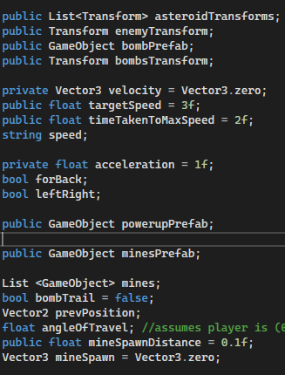
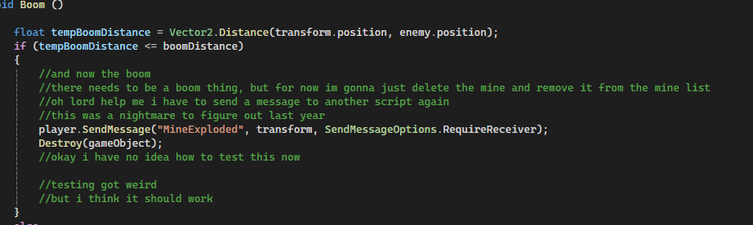
Make those bombs move
Unity Forgot What a Vector 2 was
I was pretty distressed, I still have no idea what happened
But once it remembered (after restarting a few times)
The movement was easy!
Until it wasn’t
Notes:
Yeah Send Message isn’t my strong suit still
Also how to handle the destroy was a lil weird, but I got there
Mostly it was just several tests to see how it happened in my main code on player

Slide 6

Disco Ship
Notes:
So I wanted to turn the ship as you drove it
Which is theoretically, pretty easy, sadly I was sick the week we did rotate
I tried to use Vector3.Lookat but that didn’t work out so well

Slide 7
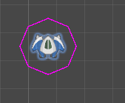

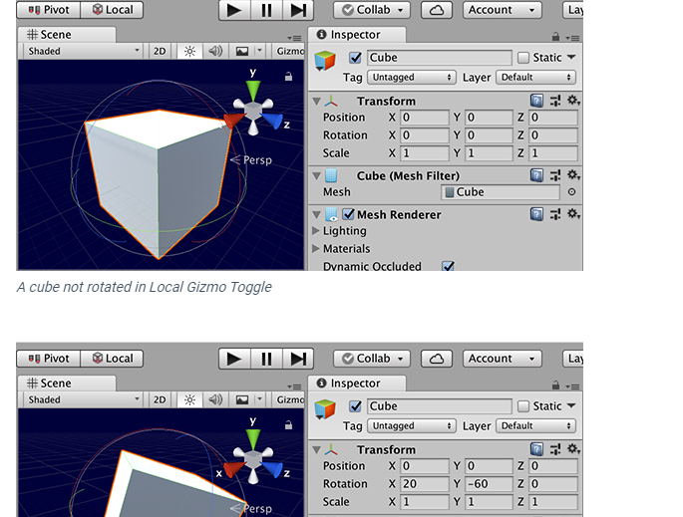
Houston I’ve lost a spaceship
At first tried the Vector3.Lookat
Except that uses the Z axis as the forwards, not the Y
So the ship left
Also turns out, I don’t understand eulers
Notes:
After losing the ship I kind of ran out of steam, but it was an interesting learning experience how Z is forwards and how lookat works.

